Slide 1
COMUTER GRAPHICS AND VISUALIZATION 18CS62
Faculty Name : Sougandhika Narayan
Asst. Professor, Department of CSE
KSIT, Bangalore

Slide 2
K S INSTITUTE OF TECHNOLOGY
VISION
“To impart quality technical education with ethical values, employable skills and research to achieve excellence”
MISSION
To attract and retain highly qualified, experienced & committed faculty.
To create relevant infrastructure.
Network with industry & premier institutions to encourage emergence of new ideas by providing research & development facilities to strive for academic excellence.
To inculcate the professional & ethical values among young students with employable skills & knowledge acquired to transform the society.

Slide 3
DEPARTMENT OF COMPUTER SCIENCE & ENGINEERING
VISION
“To create competent professionals in Computer Science and Engineering with adequate skills to drive the IT industry”.
MISSION
Impart sound technical knowledge and quest for continuous learning.
To equip students to furnish Computer Applications for the society through experiential learning and research with professional ethics.
Encourage team work through inter-disciplinary project and evolve as leaders with social concerns.

Slide 4
DEPARTMENT OF COMPUTER SCIENCE & ENGINEERING
Program Educational Objectives (PEOs)
After 2-3 years of graduation, the students will have the ability to:
PEO1: Excel in professional career by acquiring knowledge in cutting edge technology and contribute to the society as an excellent employee or as an entrepreneur in the field of Computer Science & Engineering.
PEO2: Continuously enhance their knowledge on par with the development in IT industry and pursue higher studies in Computer Science &Engineering.
PEO3: Exhibit professionalism, cultural awareness, team work, ethics, and effective communication skills with their knowledge in solving social and environmental problems by applying computer technology.

Slide 5
DEPARTMENT OF COMPUTER SCIENCE & ENGINEERING
Program Specific Outcomes
PSO1: Ability to understand, analyze problems and implement solutions in programming languages, as well to apply concepts in core areas of Computer Science in association with professional bodies and clubs.
PSO2: Ability to use computational skills and apply software knowledge to develop effective solutions and data to address real world challenges.

Slide 6
DEPARTMENT OF COMPUTER SCIENCE & ENGINEERING
Course Objectives
This course enables students of Engineering to understand and develop the computer graphics applications.
Course Outcomes:
CO1: Design and implement algorithms for 2D graphics primitives and attributes.
CO2: Construct Geometric transformations on both 2D and 3D objects.
CO3: Apply concepts of clipping and visible surface detection in 2D and 3D viewing, and Illumination Models.
CO4: Design suitable hardware and software for developing graphics packages using OpenGL.
CO5: Interview the representation of curves, surfaces, Color and Illumination models.

Slide 7
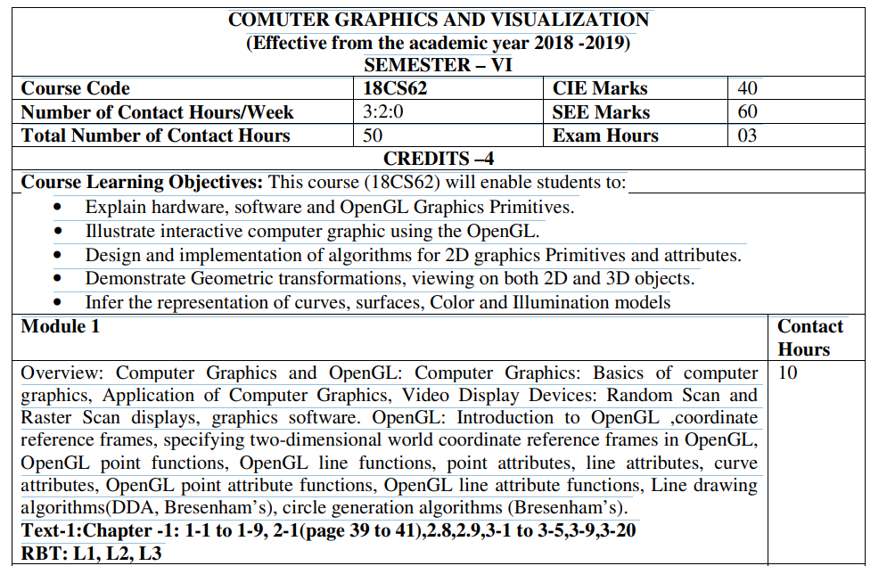

Slide 8
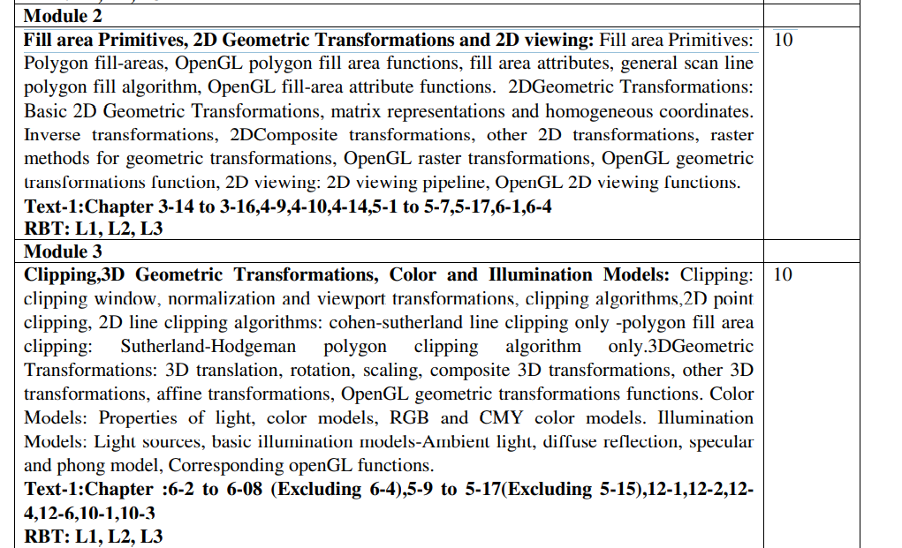

Slide 9
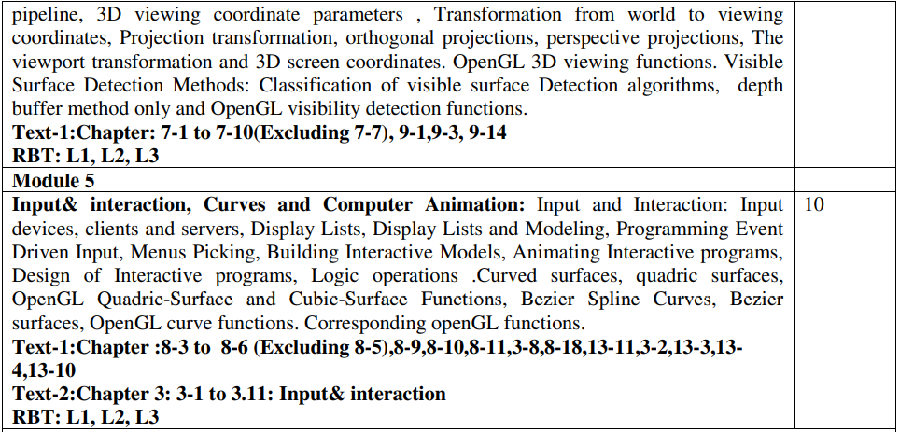

Slide 10
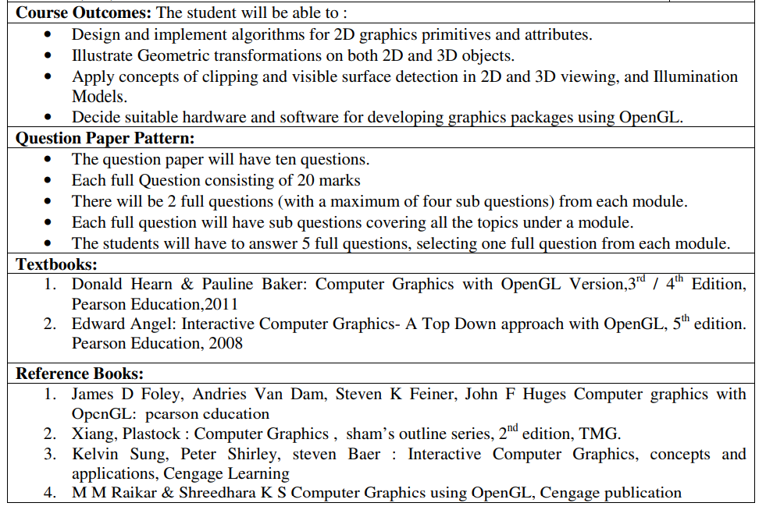

Slide 11
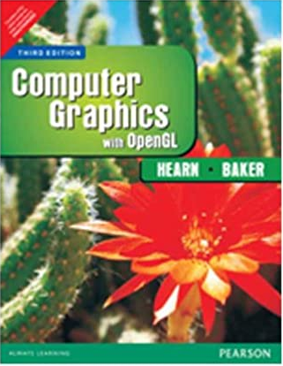

Slide 12
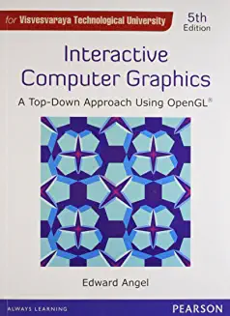

Slide 13
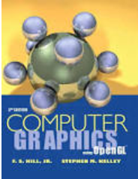

Slide 14
COMPUTER GRAPHICS
INTRODUCTION

Slide 15
Introduction to COMPUTER GRAPHICS
Computer graphics involves display, manipulation and storage of pictures and experimental data for proper visualization using a computer.
Computer graphics is an art of drawing pictures, lines, charts, etc. using computers with the help of programming. Computer graphics image is made up of number of pixels.
Pixel is the smallest addressable graphical unit represented on the computer screen.

Slide 16
Typical graphics system comprises of a host computer with support of fast processor, large memory, frame buffer and
Display devices (color monitors),
Input devices (mouse, keyboard, joystick,
touch screen, trackball)
Output devices (LCD panels, laser printers,
color printers. Plotters etc.)
Interfacing devices such as, video I/O, TV interface etc.

Slide 17
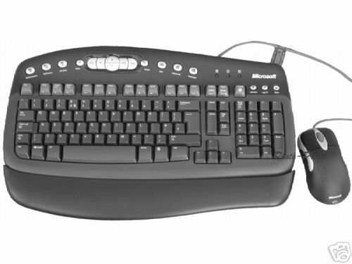
Application model
Graphics system
Application program
Application
model
Application
program
Graphics
system
Conceptual framework for
interactive graphics

Slide 18
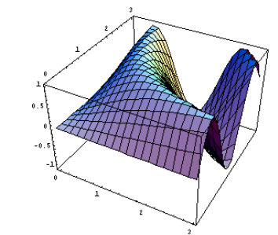
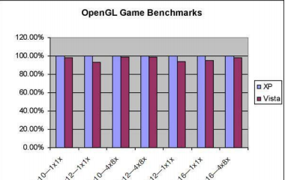
Applications of Computer Graphics
Graphs and Charts
An early application for computer graphics is the display of simple data graphs usually plotted on a character printer. Data plotting is still one of the most common graphics application.
Graphs & charts are commonly used to summarize functional, statistical, mathematical, engineering and economic data for research reports, managerial summaries and other types of publications.

Slide 19
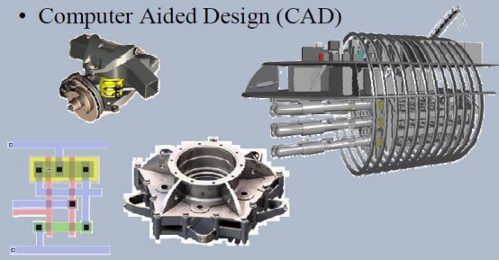
2. Computer-Aided Design
A major use of computer graphics is in design processes-particularly for engineering and architectural systems.
CAD, computer-aided design or CADD, computer-aided drafting and design methods are now routinely used in the automobiles, aircraft, spacecraft, computers, home appliances.
Circuits and networks for communications, water supply or other utilities are constructed with repeated placement of a few geographical shapes.
Animations are often used in CAD applications. Real-time, computer animations using wire-frame shapes are useful for quickly testing the performance of a vehicle or system.

Slide 20
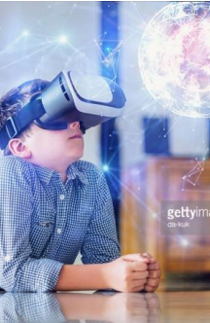
3. Virtual-Reality Environments
Animations in virtual-reality environments are often used to train heavy-equipment operators or to analyze the effectiveness of various cabin configurations and control placements.
With virtual-reality systems, designers and others can move about and interact with objects in various ways. Architectural designs can be examined by taking simulated “walk” through the rooms or around the outsides of buildings to better appreciate the overall effect of a particular design.
With a special glove, we can even “grasp” objects in a scene and turn them over or move them from one place to another.

Slide 21
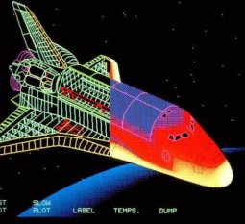
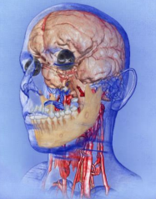
4. Data Visualizations
Producing graphical representations for scientific, engineering and medical data sets and processes is another fairly new application of computer graphics, which is generally referred to as scientific visualization. And the term business visualization is used in connection with data sets related to commerce, industry and other nonscientific areas.
There are many different kinds of data sets and effective visualization schemes depend on the characteristics of the data. A collection of data can contain scalar values, vectors or higher-order tensors

Slide 22
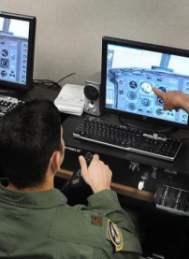
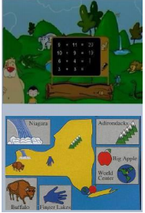
5. Education and Training
Computer generated models of physical, financial, political, social, economic & other systems are often used as educational aids.
Models of physical processes physiological functions, equipment, such as the color coded diagram as shown in the figure, can help trainees to understand the operation of a system.
For some training applications, special hardware systems are designed. Examples of such specialized systems are the simulators for practice sessions ,aircraft pilots, air traffic control personnel.
Some simulators have no video screens, for eg: flight simulator with only a control panel for instrument flying

Slide 23
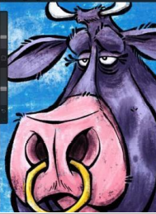
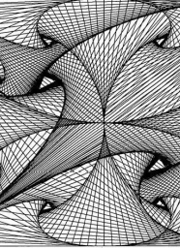
6. Computer Art
The picture is usually painted electronically on a graphics tablet using a stylus, which can simulate different brush strokes, brush widths and colors.
Fine artists use a variety of other computer technologies to produce images. To create pictures the artist uses a combination of 3D modeling packages, texture mapping, drawing programs and CAD software etc.
Commercial art also uses theses “painting” techniques for generating logos & other designs, page layouts combining text & graphics, TV advertising spots & other applications.
A common graphics method employed in many television commercials is morphing, where one object is transformed into another.

Slide 24


7. Entertainment
Television production, motion pictures, and music videos routinely a computer graphics methods.
Sometimes graphics images are combined a live actors and scenes and sometimes the films are completely generated a computer rendering and animation techniques.
Some television programs also use animation techniques to combine computer generated figures of people, animals, or cartoon characters with the actor in a scene or to transform an actor’s face into another shape.

Slide 25
8. Image Processing
The modification or interpretation of existing pictures, such as photographs and TV scans is called image processing.
Methods used in computer graphics and image processing overlap, the two areas are concerned with fundamentally different operations.
Image processing methods are used to improve picture quality, analyze images, or recognize visual patterns for robotics applications.
Image processing methods are often used in computer graphics, and computer graphics methods are frequently applied in image processing.

Slide 26
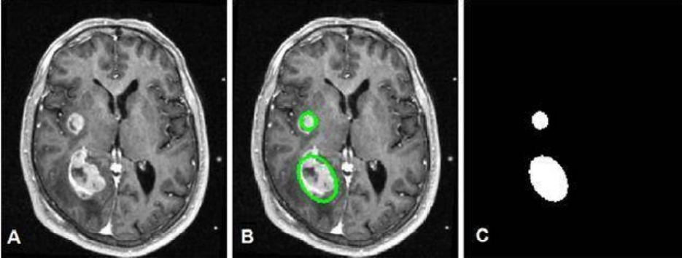
Image Processing Contd….
Medical applications also make extensive use of image processing techniques for picture enhancements in tomography and in simulations and surgical operations.
It is also used in computed X-ray tomography(CT), position emission tomography(PET) and computed axial tomography(CAT).

Slide 27
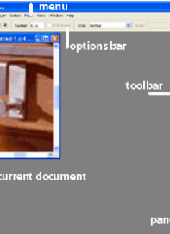
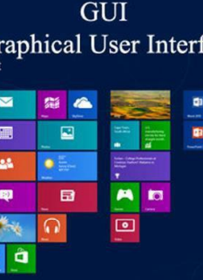
9. Graphical User Interfaces
It is common now for applications software to provide graphical user interface (GUI).
A major component of graphical interface is a window manager that allows a user to display multiple, rectangular screen areas called display windows.
Each screen display area can contain a different process, showing graphical or nongraphical information, and various methods can be used to activate a display window.
Using an interactive pointing device, such as mouse, we can active a display window on some systems by positioning the screen cursor within the window display area and pressing the left mouse button.

Slide 28
Typical applications areas are
GUI • Plotting in business
Office automation • Desktop publishing
Plotting in science and technology
Web/business/commercial publishing and advertisements
CAD/CAM design
(VLSI, Construction, Circuits)
Scientific Visualization

Slide 29
Entertainment
(movie, TV Advt., Games etc.)
Simulation studies •
Cartography •
Simulators
Multimedia
Virtual reality
Process Monitoring
Digital Image Processing
Education and Training

Slide 30
GUI – Graphical User Interface
Typical Components Used:
Menus
Buttons
Icons
Valuators
Cursors
Grids
Dialog Boxes
Sketching
Scroll Bars
3-D Interface

Slide 31
Graphics Kernel System
GKS –
by ISO (International Standards Organization) & ANSI (American National Standards Institute)
SRGP –
Simple Raster Graphics Package
PHIGS –
Programmers Hierarchical Interactive Graphics System

Slide 32
Various application packages and standards are available:
Core graphics
GKS
SRGP
PHIGS, SPHIGS and PEX 3D
OpenGL (with ActiveX and Direct3D)
X11-based systems.

Slide 33
On various platforms, such as
DOS, Windows,
Linux, OS/2,
SGI, SunOS,
Solaris, HP-UX,
Mac, DEC-OSF.

Slide 34
Various utilities and tools available for web-based design include: Java, XML, VRML and GIF animators.
Certain compilers, such as, Visual C/C++, Visual Basic, Borland C/C++, Borland Pascal, Turbo C, Turbo Pascal, Gnu C/C++, Java provide their own graphical libraries, API, support and help for programming 2- D/3-D graphics.
Some these systems are
device-independent (X11, OpenGL )
device-dependent (Solaris, HP-AGP ).

Slide 35
Four basic output primitives (or elements) for drawing pictures:
POLYLINE
Filled POLYGONS (regions)
Four major areas of Computer Graphics are:
Display of information,
ELLIPSE (ARC)
TEXT
Design/Modeling,
Raster IMAGE
Simulation and
User Interface.

Slide 36
Computer Graphics systems could be active or passive.
In both cases, the input to the system is the scene description and output is a static or animated scene to be displayed.
In case of active systems, the user controls the display with the help of a GUI, using an input device.
Computer Graphics is now-a-days, a significant component of almost all systems and applications of computers in every field of life.

Slide 37
Various fundamental concepts and principles
in Computer Graphics are
Display Systems
Storage displays, Random scan, Raster refresh displays, CRT basics, video basics, Flat panel displays.
Transformations
Affine ( 2-D and 3-D ): Rotation, Translation, Scale, Reflection and Shear.
Viewing: The Camera Transformations - perspective, orthographic, isometric and stereographic views, Quaternion.

Slide 38
Scan Conversion and Clipping
Drawing of Points, Lines, Markers, Curves,
Circles, Ellipse, Polyline, Polygon. Area filling, fill-style, fill pattern, clipping algorithms, anti-aliasing etc.
Hidden Surface Removal
Back face culling, Painter's algorithm, scan-line algorithm, BSP-trees, Z-buffer/sorting, Ray tracing etc.
Shading & Illumination
Phong's shading model, texture mapping, bump
mapping, Gouraud shading, Shadows and background, Color models etc.

Slide 39
Solid Modeling
Wire-frame, Octrees, Sweep, Boundary representations. Regularized Boolean set operations, Constructive Solid Geometry.
Curves and Surfaces
Bezier (Bernstein Polynomials) Curves, B- Splines, Cubic-Splines, Quadratic surfaces, parametric and non-parametric forms, Hermite Curves etc.

Slide 40
Miscellaneous
Animation, Fractals, Projection and Viewing, Geometry, Modeling, Image File
formats, Image Morphing, Interaction (sample and event-driven) etc.
Advanced Raster Graphics Architecture Display Processors, Pipeline and parallel
architectures, multi-processor systems, hybrid architectures.

